Slide 1
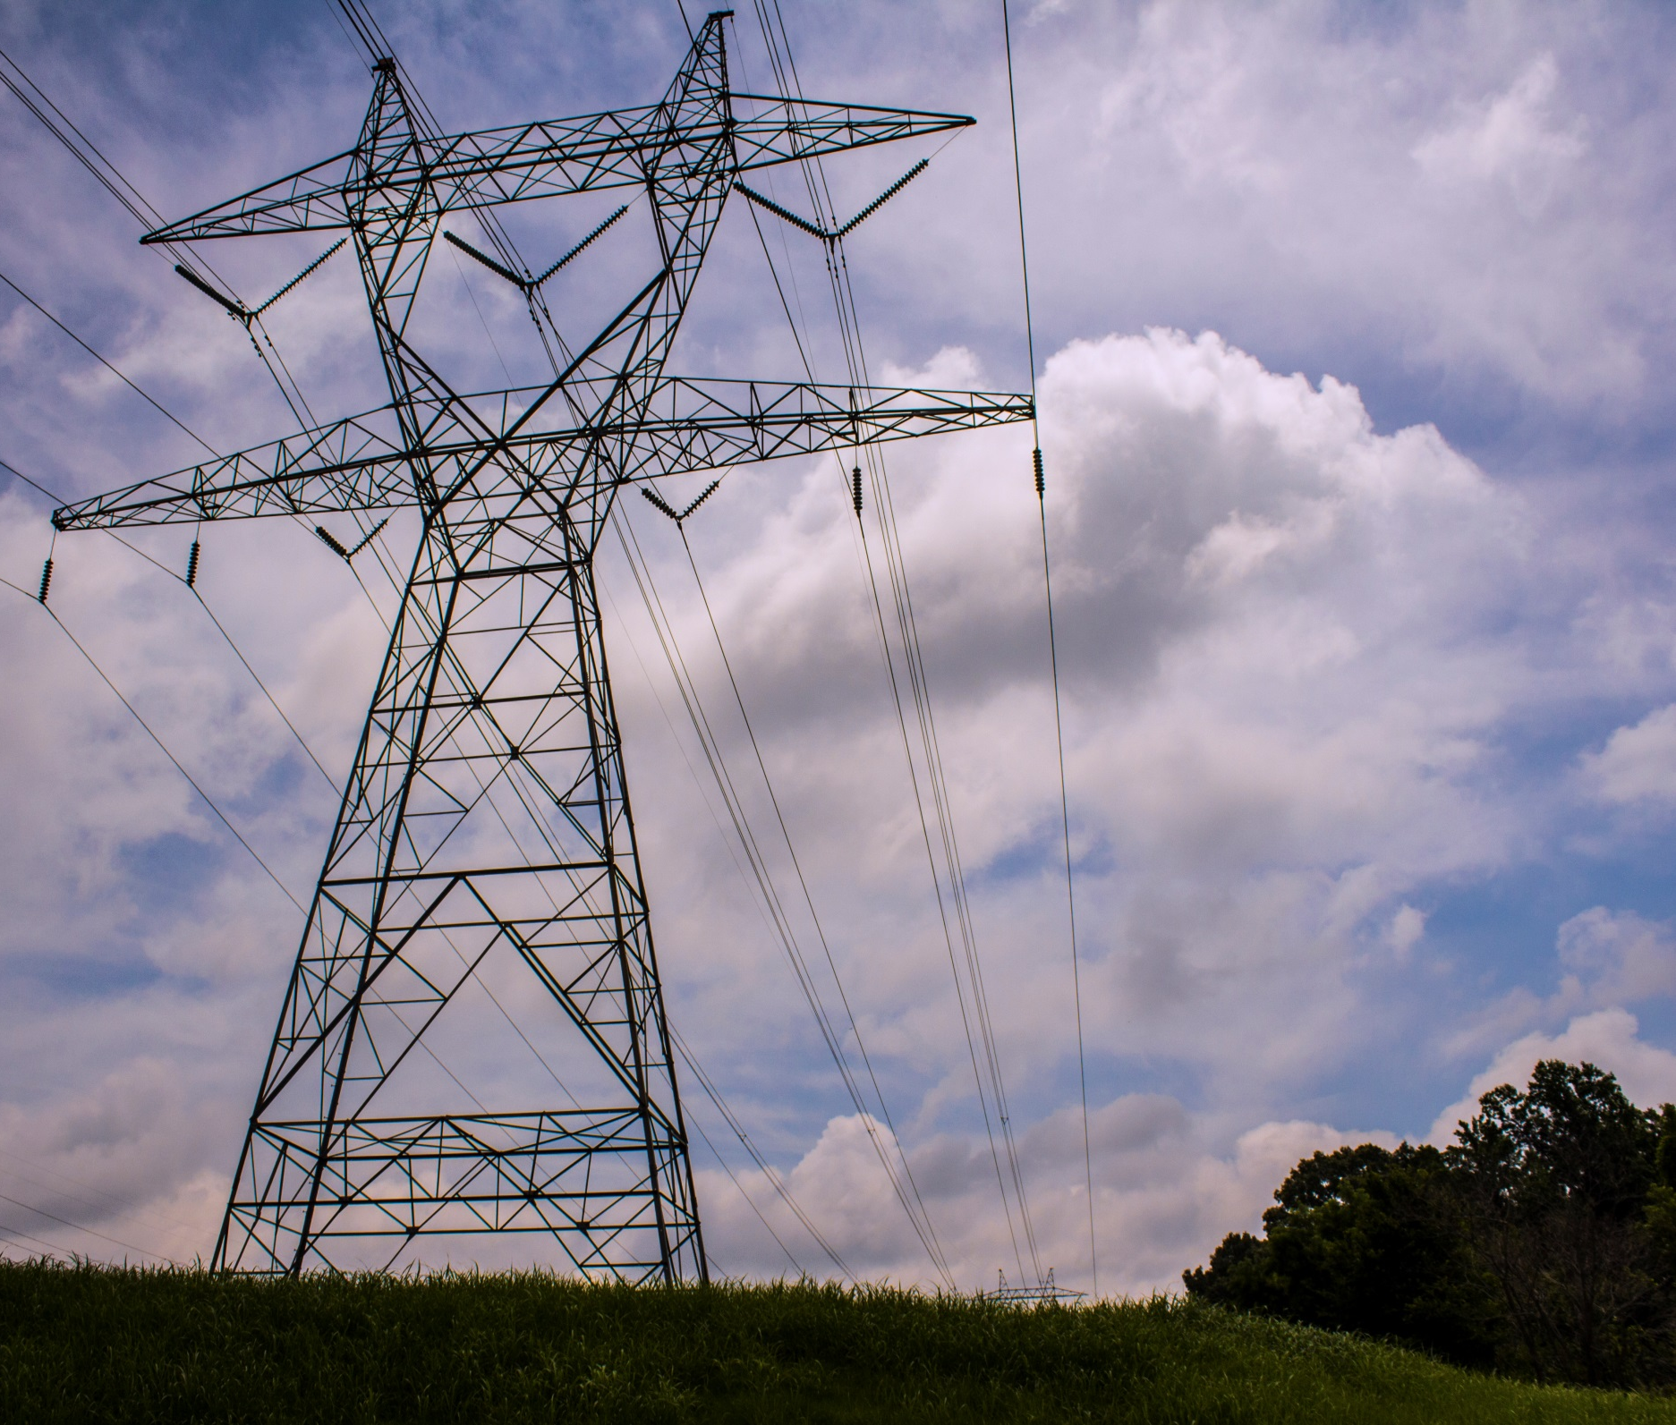
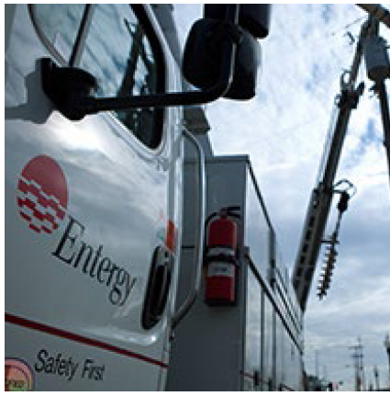

AEF Annual Convention 2018
“How To Ace an Inspection”
Russell McLaren – Entergy ARES Water Lead
October 4, 2018

Slide 2
AEF Convention – How to Ace an Inspection
Points of Discussion:
  Inspectors
  Types of Inspections
  How Do I Ace an Inspection
  How to Stay “Audit Ready”
1

Slide 3
AEF Convention – How to Ace an Inspection
District Inspectors have multifaceted job duties that include the following:
Permit compliance evaluation inspections for facilities with National Pollutant Discharge Elimination System (NPDES) permits. These facilities have discharges to surface water and include primarily municipal wastewater treatment plants and industries that discharge process wastewater.
Stormwater inspections that address stormwater runoff from construction and industrial sites.
Permit compliance inspections for subsurface or no-discharge facilities permitted by ADEQ. Such inspections include septic tank systems, animal waste facilities, and deep-well brine injection at oil and gas production fields.
Investigating citizens' complaints.
Responding to spills of materials from industries, transportation systems, and municipalities to assure protection of the environment.
Investigating fish kills related to environmental causes.
Collecting routine water samples from a network of sampling stations to monitor ambient water quality of the waters of Arkansas.
1

Slide 4
AEF Convention – How to Ace an Inspection
Types of Water Inspections:
  NPDES Industrial Permits
  NPDES General Stormwater
  NPDES General Stormwater Construction
1

Slide 5
AEF Convention – How to Ace an Inspection
How Do I Ace an Inspection?
  Relax
  Prepare
  Cooperate/Defend
  Respond
1

Slide 6
AEF Convention – How to Ace an Inspection
RELAX!
  Warning Contact
  Let Appropriate Plant Personnel Know
  Remember Inspectors are not “Out to Get You”
  Don’t Try to Hide Your Weak Spots
  Don’t Over Compensate – Hush!
  Always be Honest
1

Slide 7
AEF Convention – How to Ace an Inspection
Prepare
  Know Your Permit!
  Clean Up the Facility and Your Office
  Get your Files in Order and Up to Date
  Check That Associated Documentation is in Order
  Update Plans as Necessary – Living Documents
  Know Your Plant Situation – Normal Procedures?
1

Slide 8

AEF Convention – How to Ace an Inspection
Cooperate/Defend
  Cooperate to the Fullest Extent
  Inspectors are Not Always Right; Neither are You
  Respectfully Defend Your Position
  Ask for Confirmation Before the Inspector Leaves
1

Slide 9
AEF Convention – How to Ace an Inspection
Respond
  Inspection Report
  Review the Report Carefully
  Always Respond to Deficiencies or Request for Additional Information
  Get Help if Necessary
1

Slide 10
AEF Convention – How to Ace an Inspection
How to Stay Audit Ready
  Entergy Arkansas Inspection Directive
  Always Be a “Good Actor”
  Review the ADEQ Inspection Forms
  Know the Inspection Evaluation Areas
  Know the Details
1

Slide 11

AEF Convention – How to Ace an Inspection
How to Stay Audit Ready
  Entergy Arkansas Inspection Directive
  Internal Assessments?
1

Slide 12

AEF Convention – How to Ace an Inspection
How to Stay Audit Ready
  Always Be a “Good Actor”
1

Slide 13
AEF Convention – How to Ace an Inspection
How to Stay Audit Ready
  Review the ADEQ Inspection Forms
    Compliance Evaluation Forms
    Look at Previous Inspection Reports
    Look at other Inspection Reports on ADEQ Website
1

Slide 14
AEF Convention – How to Ace an Inspection
How to Stay Audit Ready
  Know the Inspection Evaluation Areas
    Permit
    Records/Reports
    Operation & Maintenance
    Sampling
    Flow Measurement
    Laboratory
    Effluent/Receiving Waters
    Sludge Handling/Disposal
    Facility Site Review
1

Slide 15
AEF Convention – How to Ace an Inspection
How to Stay Audit Ready
  Know the Details
    NPDES Industrial
    NPDES Stormwater
    Construction Stormwater
1

Slide 16
AEF Convention – How to Ace an Inspection
How to Stay Audit Ready
  Know the Details: NPDES Industrial
    Analytical Results Consistent with the results on the DMRs?
    Results of Calibrations?
    Effluent Loadings Calculations are accurate?
    Tracking Bypasses and Overflows?
    Reporting Additional Monitoring?
    All Flow Being Monitored and Instrumentation Calibrated?
    Laboratory QA/QC Adequate and Accurate? (Lab Audit)
    Sludge/Solids Management and Removal Documented?
    Flow Proportioned Samples Collected as Necessary?
    Appropriate Notifications Made When Violations Occur?
1

Slide 17
AEF Convention – How to Ace an Inspection
How to Stay Audit Ready
  Know the Details: NPDES Stormwater
    Has the SWPPP Been Properly Updated?
    Do the Pollution Prevention Team Members Have Responsibilities?
    Does the Facility Map Show the Size of the Property in Acres?
    Does the Map Show Receiving Waters in the Vicinity ?
    Locations of Sources of Run-on to the Site?
    Non-Storm Water Discharge Certification?
    Employee Training Records Up to Date?
    Inspections, Sampling and SWAR Being Conducted?
    Stormwater Discharge to a 303(d) or TMDL Stream?
    Is the SWPPP Signed and Certified?
    Benchmark Exceedances Documented? (CAP?)
1

Slide 18
AEF Convention – How to Ace an Inspection
How to Stay Audit Ready
  Know the Details: Construction Stormwater
    Is the Site Posted
    SWPPP in Place?
    BMPs in Place?
    Inspections Being Conducted
    Making Appropriate Changes/Repairs
1

Slide 19

AEF Convention – How to Ace an Inspection
Questions or Comments….Experiences?
1

